Slide 1
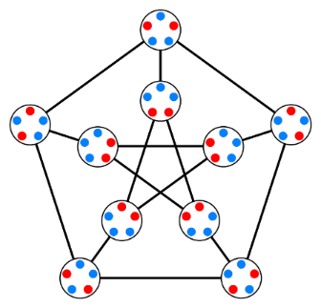
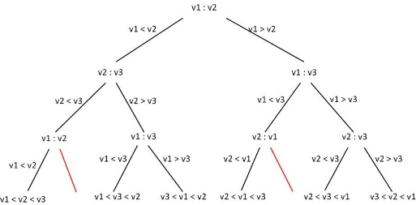
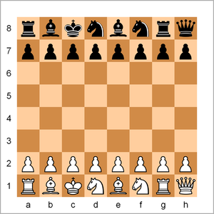
Discrete Structures (Discrete Mathematics)
Mr. Asim Raza
Email: asim.raza@ucp.edu.pk
My office:
F202, A building

Slide 2
Relations

Slide 3
Relations
Whenever sets are being discussed, the relationship between the elements of the sets is the next thing that comes up.
Relations may exist between objects of the same set or between objects of two or more sets.

Slide 4
Relations – Definition
Relation: Let A and B be two sets. A binary relation (R) from A to B is a subset of A x B, i.e., R ⊆ AxB.
Example 1: Let A={1, 2, 3,4,5} and B={1,2,3}.
AxB = {(1,1),(1,2),(1,3),(2,1),(2,2),(2,3),(3,1),(3,2),(3,3), (4,1),(4,2),(4,3),(5,1),(5,2),(5,3)} Now, its subsets are relations e.g. R={(a,b)| a∈A,b∈B and a<b}
Hence, R={(1,2),(1,3),(2,3)}
Example 2:Find all binary relations from {0,1} to {1}.
Example 3: Let A = Set of cities; B = Set of countries. Define the relation R by specifying that (a, b) belongs to R if city a is the capital of b. For instance, (Riyadh, Saudi Arabia), (Delhi, India), (Washington, USA) are in R.

Slide 5
Relations – Example
Relation:
A (binary) relation R on set E is a subset of E×E.
Examples using E={0,1,2,3}:
The relation is =
{(0,0), (1,1), (2,2), (3,3)}
This relation is <
{(0,1), (0,2), (0,3), (1,2), (1,3), (2,3)}.
This relation is ≥.
{(0,0), (1,1), (1,0), (2,2), (2,1), (2,0), (3,3), (3,2), (3,1), (3,0)}.

Slide 6
Relations – On a Set
Relation: A relation on the set A is a relation from A to A. That is, a relation on a set A is a subset of A x A.
Example 4: Let A = {1, 2, 3, 4}. Which ordered pairs are in the relation R={(a, b) | a divides b}?
Sol: (a, b)єR iff. a and b are positive integers not exceeding 4 such that a divides b, we see that
R={(1, 1), (1, 2), (1, 3), (1, 4), (2, 2), (2, 4), (3, 3), (4, 4)}
The pairs in R are displayed graphically and in tabular form:
.1
2. .2
3. .3
4. .4
1 2 3 4 | R
X X X X X X X X | 1 2 3 4

Slide 7
Relations – Examples
Example 5: Consider the relations on the set of integers:
R₁= {(a, b) | a ≤ b},
R₂={(a, b) | a > b},
R₃={(a, b) | a = b or a = -b},
R₄={(a, b) | a = b},
R₅={(a, b) | a = b+1},
R₆={(a, b) | a+b ≤ 3},
Which of these relations contain each of the pairs (1, 1), (1, 2), (2, 1), (1, -1) and (2, 2)?
Sol: The pair (1, 1) is in R₁, R₃, R₄ and R₆; (1, 2) is in R₁and R₆; (2, 1) is in R₂, R₅ and R₆; (1, -1) is in R₂, R₃ and R₆; and finally, (2, 2) is in R₁, R₃ and R₄.

Slide 8
Relations – Representations
1 Coordinate diagram:
Let A={1,2,3} and B={x , y}. Let R be a relation from A to B defined as R={(1,y),(2,x),(2,y),(3,x)}
y
x
0
1
2
3

Slide 9
Relations – Representations
2 Arrow diagram:
Let A={1,2,3} and B={x , y}. Let R be a relation from A to B defined as R={(1,y),(2,x),(2,y),(3,x)}
1
2
3
x
y

Slide 10
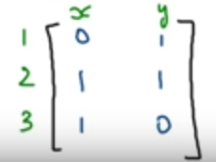
Relations – Representations
3 Matrix Representation:
Let A={1,2,3} and B={x , y}. Let R be a relation from A to B defined as R={(1,y),(2,x),(2,y),(3,x)}

Slide 11
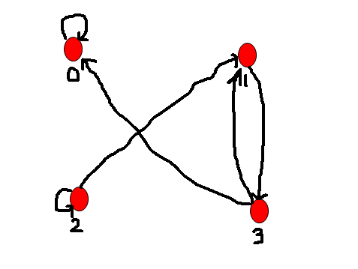
Relations – Representations
4 Directed Graph:
Let A={0,1,2,3}
R={(0,0),(1,3),(2,1),(2,2),(3,0),(3,1)}

Slide 12
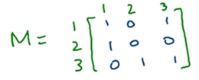
Relations – Questions
Let A = {1, 3, 5, 7} and B = {p, q, r}. Let R be a relation from A into B defined by R = {(1, p), (3, r), (5, q), (7, p), (7, q)} find the domain and range of R.
Let A = {1, 2, 3, 4} Let R be A relation on A defined by R = {a, b} : a ∈ A, b ∈ A, a is a multiple of b}. Find R, domain of R, range of R
Let A = {1, 2, 3, 4, 5, 6} Define a relation R from A to A by R {(x, y) : y = x + 2}
Depict this relation using an arrow diagram.
Write down the domain and range of R
For the relation matrix, list the set of ordered pairs represented by M and draw its directed graph.

Slide 13
Relations – Properties
Reflexivity: A relation R on a set A is called reflexive if for all a ∈ A, (a, a) ∈ R.
Example: Let A= {1,2,3,4}
R1={(1,1),(3,3),(2,2),(4,4)}
R2={(1,1),(1,4),(2,2),(3,3),(4,3)}
R3={(1,1),(1,2),(2,1),(2,2),(3,3),(4,4)}
R4={(1,3),(2,2),(2,4),(3,1),(4,4)}
Reflexive relation is a relation of elements of a set A such that each element of the set is related to itself.

Slide 14
Relations – Properties
Symmetry: A relation R on a set A is called symmetric if (b, a) ∈ R whenever (a, b) ∈ R, for all a, b ∈ A.
Example: Let A= {1,2,3,4}
R1={(1,1),(1,3),(2,4),(3,1),(4,2)}
R2={(1,1),(2,2),(3,3),(4,4)}
R3={(2,2),(2,3),(3,4)}
R4={(1,1),(2,2),(3,3),(4,3),(4,4)}

Slide 15
Relations – Properties
Transitivity: A relation on A is called transitive if (a, b) ∈ R and (b, c) ∈ R imply (a, c) ∈ R, for all a, b, c ∈ A.
Example: Let A= {1,2,3,4}
R1={(1,1),(1,2),(1,3),(2,3)}
R2={(1,2),(1,4),(2,3),(3,4)}
R3={(2,1),(2,4),(2,3),(3,4)}
R4={(1,1),(2,2),(3,3),(4,3),(4,4)}
Represent them by using directed graph and matrix. What observations do you make?

Slide 16
Relations – Properties
More examples on Transitivity
Example 2: Consider the following relations on {1, 2, 3, 4}:
R1 = {(1, 1), (1, 2), (2, 1), (2, 2), (3, 4), (4, 1), (4, 4)},
R2 = {(1, 1), (1, 2), (2, 1)},
R3 = {(1, 1), (1, 2), (1, 4), (2, 1), (2, 2), (3, 3), (4, 1), (4, 4)},
R4 = {(2, 1), (3, 1), (3, 2), (4, 1), (4, 2), (4, 3)},
R5 = {(1, 1), (1, 2), (1, 3), (1, 4), (2, 2), (2, 3), (2, 4), (3, 3), (3, 4), (4, 4)},
R6 = {(3, 4)}.

Slide 17
Relations – Properties
Example 2 Sol:
R4, R5, and R6 are transitive. For each of these relations, we can show that it is transitive by verifying that if (a, b) and (b, c) belong to this relation, then (a, c) also does. For instance, R4 is transitive, because (3, 2) and (2, 1), (4, 2) and (2, 1), (4, 3) and (3, 1), and (4, 3) and (3, 2) are the only such sets of pairs, and (3, 1), (4, 1), and (4, 2) belong to R4. You should verify that R5 and R6 are transitive.
R1 is not transitive because (3, 4) and (4, 1) belong to R1, but (3, 1) does not. R2 is not transitive because (2, 1) and (1, 2) belong to R2, but (2, 2) does not. R3 is not transitive because (4, 1) and (1, 2) belong to R3, but (4, 2) does not.

Slide 18
Relations – Properties
Example: Let A ={0,1,2}
R={(0,2),(1,1),(2,0)}
Is R is reflexive? symmetric? Transitive?
Which ordered pairs are needed in R to make it reflexive and transitive?

Slide 19
Relations – Examples
R₁= {(a, b) | a ≤ b},
R₂={(a, b) | a > b},
R₃={(a, b) | a = b or a = -b},
R₄={(a, b) | a = b},
R₅={(a, b) | a = b+1},
R₆={(a, b) | a+b ≤ 3},
Example 6: Which of the relations from Example 5 are reflexive and symmetric?
Sol: The reflexive relations from Example 5 are R₁ (because a ≤ a, for all integer a), R₃ and R₄.
For each of the other relations in this example it is easy to find a pair of the form (a, a) that is not in the relation.
The symmetric relations are R_{3,} R₄ and R₆.
R₃ is symmetric, for if a=b , then b=a .
R₄ is symmetric, since a=b implies b=a.
R₆ is symmetric, since a+b ≤ 3 implies b+a ≤ 3.
None of the other relations is symmetric.

Slide 20
Relations – Examples
Example 8: Which of the relations from Example 5 are transitive?
Sol: The transitive relations from Example 5 are R₁, R₂, R₃ and R₄. R₁ is transitive, since a ≤ b and b ≤ c imply a ≤ c. R₂ is transitive, since a > b and b > c imply a > c. R₃ is transitive, since a = ±b and b = ±c imply a = ±c. R₄ is transitive, since a = b and b = c imply a = c. R₅ and R₆ are not transitive. R5 is not transitive because (2, 1) and (1, 0) belong to R5, but (2, 0) does not. R6 is not transitive because (2, 1) and (1, 2) belong to R6, but (2, 2) does not.

Slide 21
Relations – Question
Q1: Consider following relations on {1, 2, 3}:
R₁= {(1, 1), (1, 2), (2, 1), (2, 2), (2, 3)},
R₂={(1, 1), (1, 2), (2, 2), (3, 2), (3, 3)},
R₃={(2, 1), (2, 3), (3, 1)}
R₄={(2, 3)},
Which of the relations are reflexive, symmetric, and transitive?

Slide 22
Relations – Equivalence relations
Definition: A relation on a set A is called an equivalence relation if it is reflexive, symmetric, and transitive.
1. Reflexive (∀ a ∈ A, aRa)
2. Symmetric (aRb => bRa)
3. Transitive (aRb and bRc => aRc)
Example 13: Let R be the relation on the set of real numbers such that aRb iff. a-b is an integer. Is R an equivalence relation?
Sol: As a-a = 0 is an integer for all real numbers a. So, aRa for all real numbers a. Hence R is reflexive.
Let aRb, then a-b is an integer, so b-a also an integer. Hence bRa, i.e., R is symmetric.
If aRb and bRc, then a-b and b-c are integers. So, a-c = (a-b) + (b-c) is also an integer. Hence, aRc. Thus R is transitive. Consequently, R is an equivalence relation.

Slide 23
Relations – Example
Example 14: Is the relation “divides” on the set of positive integers equivalence relation?
Sol: As a | a , whenever a is a positive integer, the “divides” relation is reflexive.
Let a | b and b | c. Then there are positive integers k and l such that b = ak and c = bl. Hence, c = a(kl). So, a | c. It follows that the relation is transitive.
This relation is not symmetric, as 1 | 2, but 2 ∤ 1.
Hence, the relation is not an equivalence relation.
Q2: Let R be the relation on the set of integers such that aRb iff. a=b or a=-b. Is R an equivalence relation?
Q3: Is the relation “≤” on the set of real numbers equivalence relation?

Slide 24
Functions

Slide 25
Definition of Functions
Given any sets A, B, a function f from (or “mapping”) A to B (f:A→B) is an assignment of exactly one element f(x)∈B
to each element x∈A.

Slide 26
Graphical Representations
Functions can be represented graphically in several ways:
f
A
B
•
•
f
•
•
•
•
•
y
a
b
•
•
•
•
x
A
B
Graph
Plot
Like Venn diagrams

Slide 27
Some Function Terminology
If f:A→B, and f(a)=b (where a∈A & b∈B), then:
A is the domain of f.
B is the codomain of f.
b is the image of a under f.
a is a pre-image of b under f.
In general, b may have more than one pre-image.
The range R⊆B

Slide 28
Range vs. Codomain - Example
Suppose that: “f is a function mapping students in this class to the set of grades {A,B,C,D,E}.”
At this point, you know f’s codomain is: __________, and its range is ________.
Suppose the grades turn out all As and Bs.
Then the range of f is _________, but its codomain is __________________.
{A,B,C,D,E}
unknown!
{A,B}
still {A,B,C,D,E}!

Slide 29
One-to-One Functions
A function is one-to-one (1-1), or injective, or an injection, iff every element of its range has only one pre-image.
Only one element of the domain is mapped to any given one element of the range.
Domain & range have same cardinality. What about codomain?
May Be
Larger

Slide 30
One-to-One Illustration
Graph representations of functions that are (or not) one-to-one:
•
•
•
•
•
•
•
•
•
•
•
•
•
•
•
•
•
•
•
•
•
•
•
•
•
•
•
Not one-to-one
Not even a function!
One-to-one

Slide 31
Onto (Surjective) Functions
A function f:A→B is onto or surjective or a surjection iff its range is equal to its codomain
An onto function maps the set A onto (over, covering) the entirety of the set B, not just over a piece of it.

Slide 32
Illustration of Onto
Some functions that are or are not onto their codomains:
•
•
•
•
•
•
•
•
•
•
•
•
•
•
•
•
•
•
•
•
•
•
•
•
•
•
•
•
•
•
•
•
•
•
•
Onto (but not 1-1)
Not Onto (or 1-1)
Both 1-1 and onto
1-1 but not onto

Slide 33
Bijections
A function f is a one-to-one correspondence, or a bijection, or reversible, or invertible, iff it is both one-to-one and onto.

Slide 34
A Couple of Key Functions
In discrete math, we frequently use the following functions over real numbers:
⎣x⎦ (“floor of x”) is the largest integer ≤ x.
⎡x⎤ (“ceiling of x”) is the smallest integer ≥ x.

Slide 35
Visualizing Floor & Ceiling
Real numbers “fall to their floor” or “rise to their ceiling.”
Note that if x∉Z, ⎣−x⎦ ≠ − ⎣x⎦ & ⎡−x⎤ ≠ − ⎡x⎤
Note that if x∈Z, ⎣x⎦ = ⎡x⎤ = x.
3
.
2
⎡1.6⎤=2
.
1.6
.
1
⎣1.6⎦=1
0
.
−1
⎡−1.4⎤= −1
.
−1.4
.
−2
.
.
.
⎣−1.4⎦= −2
−3
−3
⎡−3⎤=⎣−3⎦= −3

